Slide 1

Autonomous robots compete to push bottles and each other off of the table
V 2.0 – Updated Version for 2026 Season
This file can be found on the BottleSumo page on the website
Coaches are responsible for communicating rules updates to participants
www.robofest.net robofest@ltu.edu 248-204-3568
Room J233 Taubman Complex, LTU 21000 West 10 Mile Road, Southfield, MI 48075, USA

Slide 2
1. BottleSumo Overview (1/2)
Learning Objectives:
STEAM subjects including physics
Autonomous navigation
Computer programming logic
Edge detection
Object detection
Autonomous search algorithms
Adjusting to environmental conditions
Problem solving
Synopsis:
An Open Category competition, which will take place at the World Robofest Championship
Local events may host BottleSumo, but there are no qualifying competitions. (Teams must re-register for World Championship event)
The objective of BottleSumo to be the last robot remaining on the table
Copyright © 2025- Robofest

Slide 3
1. BottleSumo Overview (2/2)
BottleSumo competition has two sessions:
  Time Trial - to rank robots based off pushing bottles and seed a tournament bracket.
  Single Elimination Tournament - with “head to head” games and no bottles. 2 teams presented with award trophies (1st and 2nd Place)
Definitions:
  Game: a single head to head round
  Match: a series of two or more games to determine which team advances in the tournament
  Match Winner: the first team to win two games
Copyright © 2025- Robofest

Slide 4
2. Age Divisions, Team Size and Fees
Three Divisions
  Junior Classic Division (6 -14 años)
  Junior Unlimited Division (6-14 años) (New for 2026!)
  Senior Classic Division (15-19 a)
  Senior Unlimited Division (Grades 15-19)
  UNIVERSITARIOS Unlimited Division ** NO CLASIFICATORIO A LTU
Team Size: Maximum three (3) members
Teams must review and abide by: Robofest 2026 General Rules
Each team member must bring the signed Robofest Consent and Release Form on the day of the event, if not completed online
Copyright © 2025- Robofest

Slide 5
3.1 Robot Requirements (1/3)
Robots must be created by students. If a team is identified to have a robot too similar to another robot (including robots from the same organization and both Jr and Sr divisions) or clearly not their own, team will be subject to investigation (design and code interviews) and possible robot changes, penalties, or disqualification
Robot must be fully constructed upon arrival to the competition
Robot must be fully autonomous. No human control, signal, or remote computer control (tele-op)
One robot per team (same robot must be used for entire tournament)
Labeling requirements:
  Robofest Team ID on any visible surface – (Team Name optional)
  “Front” indicator on the side with sensors, which must remain the same throughout the tournament
Teams will need to bring a laptop computer to modify their programs to adjust for conditions on competition day
Copyright © 2025- Robofest

Slide 6
3.1 Robot Requirements (2/3)
 | Junior Classic | Senior Classic | Junior Unlimited | Senior Unlimited & UNIVERSITARIOS
Maximum robot weight | 1.2 Kg | 1.5 Kg | 2.5 Kg | 3 Kg
Maximum robot width, length, and height | Must fit in 21x21x21cm box. Robots may NOT expand their dimensions beyond this maximum | Must fit in 30x30x30cm box. Robots may NOT expand their dimensions beyond this maximum | Must fit in 30x30x30cm box. Robots may NOT expand their dimensions beyond this maximum
Number of robot brains | One brain only | Any number | Any number
Robot brain limits | LEGO NXT, LEGO EV3, LEGO SPIKE Prime/Robot Inventor, VEX IQ (Gen 1 or Gen 2 only) |  | Any
Robot battery limits | Voltage is limited to <= 9.0v |  | No limit
Wheels, treads, or legs (the parts driven by motors which touch the ground) | Must be standard, unmodified LEGO or VEX IQ parts. Vacuum or sticky material NOT allowed |  | Vacuum or sticky material NOT allowed
Robot Shape | Ramps not allowed. Front, rear, and sides of robot (outer envelope of the robot, 25mm or lower from the ground) cannot be sloped or horizontal. Motors must be visible so they can be inspected
Copyright © 2025- Robofest

Slide 7
3.1 Robot Requirements (3/3)
 | Junior Classic | Senior Classic | Junior Unlimited | Senior Unlimited & UNIVERSITARIOS
Sensor requirements | At least one sensor that can detect dark/light contrast on the plane of the table AND at least one sensor that can detect objects in front
Number of sensors | Maximum 4 (Sensor Multiplexer* NOT allowed) |  | Unlimited (Sensor Multiplexers* ALLOWED)
Sensor types** | LEGO or VEX IQ Sensors, must use standard wires |  | Any, unless harmful to humans
On-board vision sensor system | NOT allowed |  | Examples of allowed vision sensors: Pixycam smart phone vision
Number of motors | Maximum 3 |  | Unlimited
Motor types** | LEGO NXT, LEGO EV3, LEGO SPIKE Prime or VEX IQ. Voltage altering over default voltage is NOT allowed Other motors such as LEGO Power Function and EV3 medium motors NOT allowed |  | Any type
Materials | LEGO or VEX IQ parts only |  | Any materials. You may use tape, glue, rubber bands, etc. to construct the robot
Programming language | Any
*Multiplexer allows the use of one port for multiple sensor channels
**See Section 3.2 for list of allowable motors and sensors for Jr Classic and Sr Classic
Copyright © 2025- Robofest

Slide 8
3.2 Allowable Parts: Jr Classic and Sr Classic
Platform | Motors | Sensors
LEGO SPIKE Prime | LEGO SPIKE Prime (45602,45603) | LEGO Technic Distance Sensor 45604 LEGO Technic Color Sensor 37308 LEGO Technic Force Sensor 37312
LEGO EV3 |  | LEGO EV3 Color Sensor 45506 LEGO EV3 Ultrasonic Sensor 45504 LEGO EV3 Infrared Sensor 45509 LEGO EV3 Gyro Sensor 45504 LEGO EV3 Touch Sensor 45507 LEGO NXT Light Sensor 55969 LEGO NXT Ultrasonic Sensor 53792 LEGO NXT Color Sensor 64892 LEGO NXT Touch Sensor 53793
 | LEGO EV3 (455202)
 | LEGO NXT (9842)
LEGO NXT
VEX IQ | VEX IQ (228-2560) | VEX IQ Color Sensor 228-3012 VEX IQ Optical Sensor 228-7082 VEX IQ Distance Sensor (Gen 1) 228-3011 VEX IQ Distance Sensor (Gen 2) 228-7106 VEX IQ Touch Sensor 228-2677 VEX IQ Gyro Sensor 228-3014 VEX IQ TouchLED 228-3010
Copyright © 2025- Robofest

Slide 9
3.3 Special World Championship Rules
Jr Classic and Sr Classic teams must use motors issued by Robofest for the competition. Teams will exchange their team motors for Robofest issued motors before worktime
Teams will use the worktime to reassemble their robots. Motors will be exchanged back after the tournament.
The first worktime will be increased to 30 minutes. Teams must be able to change out the motors and be ready by the end of the work time.
Copyright © 2025- Robofest

Slide 10
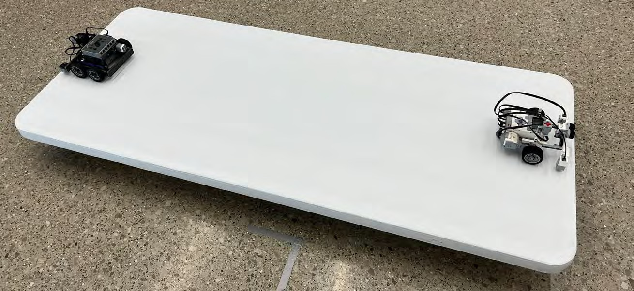
4. BottleSumo Playing Fields (1/2)
Junior and Senior Divisions: Made up of one table
Common Set up for Head to Head rounds
Copyright © 2025- Robofest

Slide 11
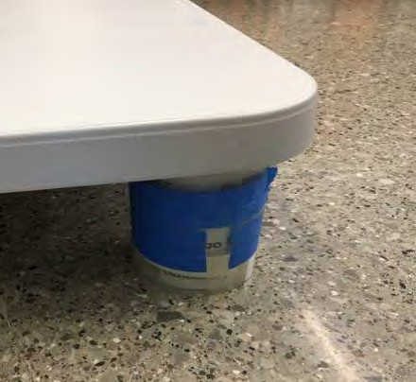





4. BottleSumo Playing Fields (2/2)
Competition tables are 30in x72in (actual size is about 75cm x 182cm) plastic folding tables
The recommended brand is “Lifetime” which can be found at https://www.lifetime.com/lifetime-2901g-6-foot-folding-table-commercial
The four corners of the table are rounded
The radius of the corner circle is 4cm ~ 7cm
Table thickness is about 4.5cm
Table surface is light in color, for example, almond, tan, or gray
Exact size, color, brightness, and edge shape are unknown until the day of the competition
12.75 cm
3 stacked packaging tapes
Raised Table Setup for all Divisions
The table is placed on a dark colored floor with the legs folded under and raised up with rolls of packing tape (a stack of three recommended)
Copyright © 2025- Robofest

Slide 12
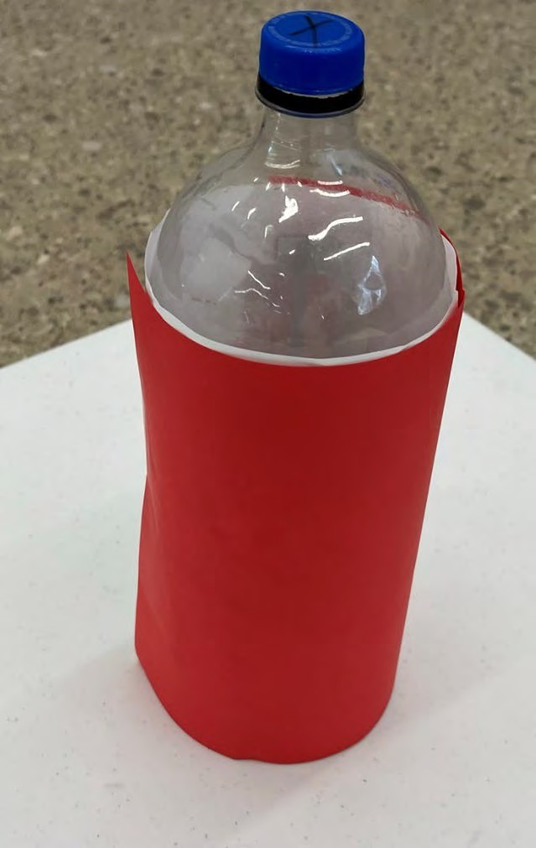
5. Bottle Specification: Used For Time Trials
A two-liter bottle covered with red paper (8.5in x 14in, may take 2 pieces of paper)
The exact color of the red paper is unknown until the competition day
Bottle is filled with 1 kg of sand
FOR LOCAL EVENTS:
  If the two-liter bottle shown right is not available, a slimmer bottle may be modified by using materials like yoga mats or sponge sheets
OR
21.6cm (8.5”)
Thinner bottles may also be used without modification
Bottle Dimensions
Copyright © 2025- Robofest

Slide 13
6. Robot Start Task
Robots must have a 3-second delay before moving
The 3-second delay is required for the Time Trials and the Head to Head matches
All values must be preprogrammed before the impound ends. After impound, on-field calibration and adjustments (using buttons, switches, etc.) are NOT allowed.
Robots must be started the same way (same button, switch, etc.) for each time trial and game
Any preset motion must be the same for each game (for example: robot initially turns left 90 degrees or robot turns left until object detected)
Copyright © 2025- Robofest

Slide 14
7. Competition Procedures
Only participants are allowed to access the pit area, team tables, practice fields and official game fields throughout the competition day including: setup time before opening ceremony, work time, and breaks
Immediately after the opening ceremony, a 15 minute (30 min for World Championship) timer will start for teams to make final adjustments to their robots
After the work period, all the robots will be inspected and then impounded
During impound, the robot will be inspected for size, weight, and labels. Judges will also inspect the robot for any illegal materials and document the program (name/slot number) that will be used and the method of starting the robot
Battery charging is not allowed in impound
Participants should not pick up their robot until instructed by a Judge
Copyright © 2025- Robofest

Slide 15
8.1 Time Trial Round Rules (1/2)
At the start of each Time Trial, the Judge will announce (a) the location of the robot (b) orientation of the robot. The same location/orientation will be used for all time trials during an event
Teams will place their robots on the field according to the Judge’s instructions
The bottle locations for the Time Trial will be announced after impound. The same bottle arrangement will be used for all teams during an event
Judge will measure the time taken for each robot (one per table) to push 5 bottles off the table
Time will be recorded to 1/100 of a second, starting from zero
Maximum time given is 2 minutes (120 seconds)
If a robot falls off the table or does not knock off all the bottles, survival time and number of bottles pushed off the table will be recorded. (See examples in section #9.2)
Robot must remain intact and on the table for at least 3 seconds after any bottle is pushed off or it will be penalized. The 3 seconds is not included in the recorded time.
Copyright © 2025- Robofest

Slide 16
8.1 Time Trial Round Rules (2/2)
Time will be measured until one of the following occurs:
  The fifth bottle is knocked off “Completion Time”
  The robot falls off the table (Survival Time)
  The robot stays on the table but is still running at the 2 minute mark (“120 sec Survival Time”)
After all teams have completed the Time Trial, teams will have an additional 15 minutes to modify robot or program
During this time, a single elimination seeded tournament bracket will be created based on the rankings from the Time Trials. (http://www.printyourbrackets.com)
Teams will be seeded (ranked) based on the following:
  Start Task completion
  Number of bottles
  Staying on the table for at least 3 seconds after pushing any bottle off
  Completion Time or Survival Time
Time Trial calculations will be managed in the Time Trial Scoresheet: https://www.robofest.net/images/2526/BottleSumo2026TTScoresheet.xlsx
Copyright © 2025- Robofest

Slide 17
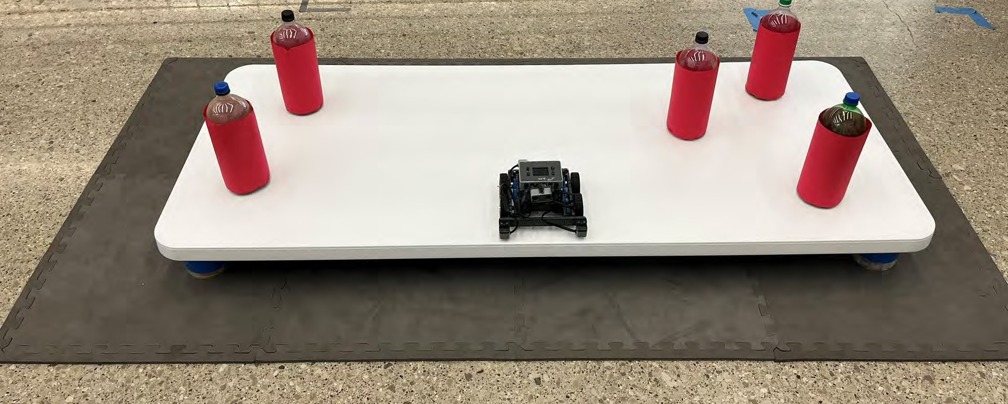
8.2 Example Time Trial Set Up
Bottle locations are unknown (announced after impound). The same bottle arrangement will be used for all teams during an event
Copyright © 2025- Robofest

Slide 18
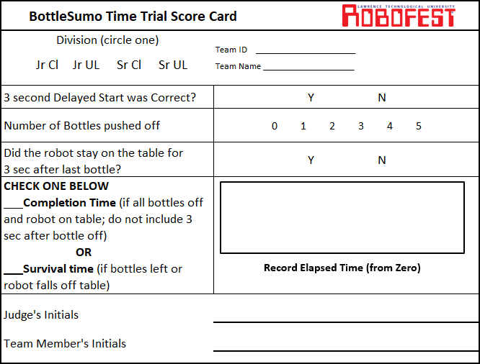
9.1 Time Trial Score Card
https://www.robofest.net/images/2526/BottleSumo2026TTScorecard.pdf
Copyright © 2025- Robofest

Slide 19
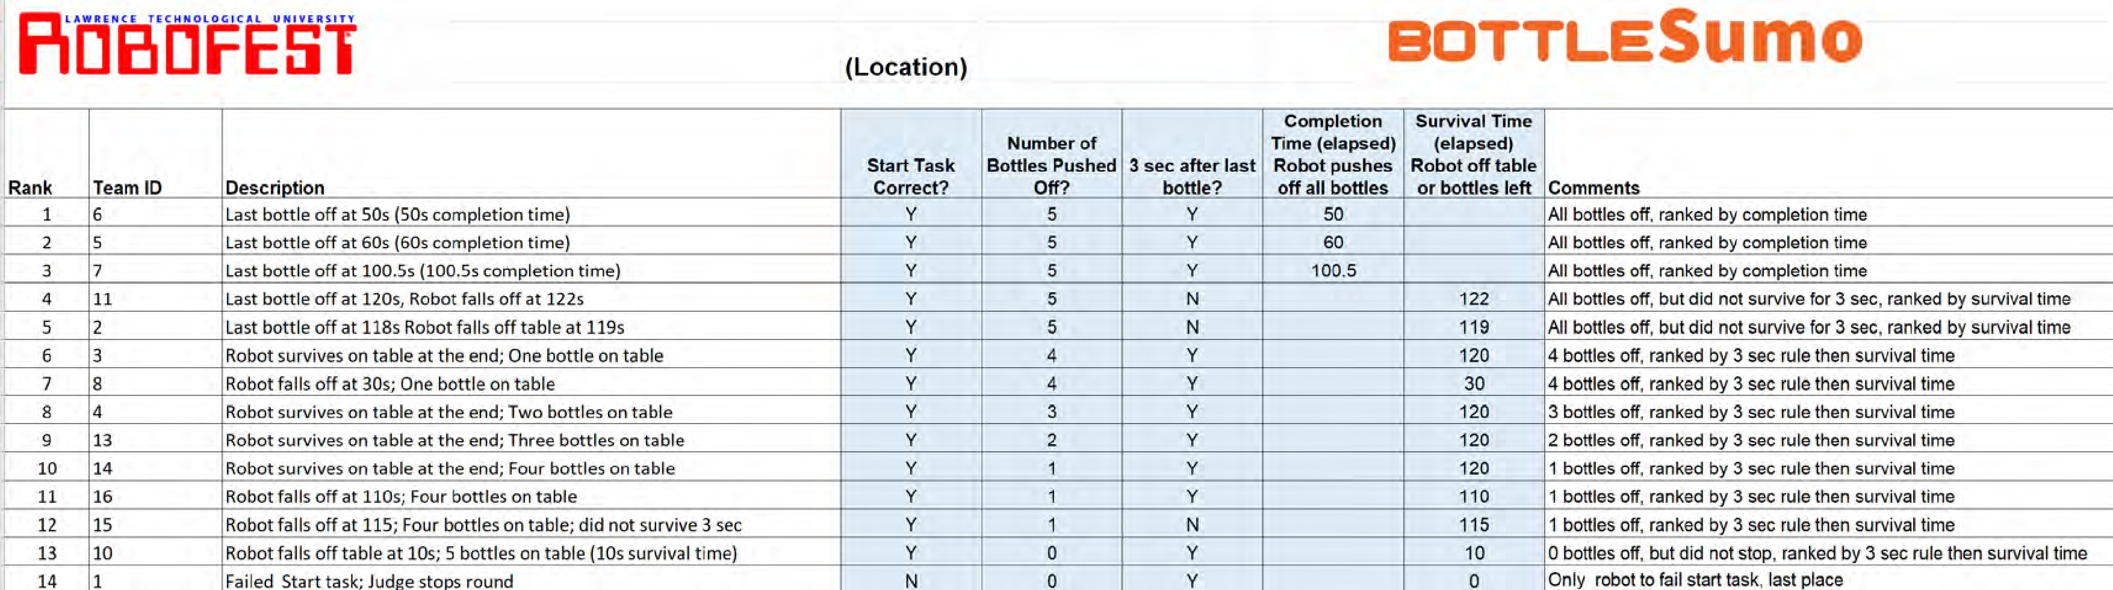
9.2 Time Trial Ranking Example
(*) Note that Team 16 was ranked ahead of Team 15 because Team 15 did not survive 3 sec after the bottle fell off
Copyright © 2025- Robofest

Slide 20
10. Game (Head to Head) Rules: Two Robots/No Bottles
A maximum of 2 minutes is given for each game
At the start of each game, the Judge will announce (a) the location of the robots (b) orientation of the robots. Location and orientation may be different for each game
Teams will place their robots on the field according to the Judge’s instructions
The robot must have a 3-second delay before moving
If the robot fails to move, the robot automatically loses the game, unless the other robot also fails to move, in which case it is a tie
If the robot fails 3-second delay requirement, the robot automatically loses the game, unless the other robot also fails the 3-second delay requirement, in which case it is a tie
After the start, students/Judges must move at least 1 meter away from the table edges until after the end of the game
If any piece/part of the robot comes off the robot, and subsequently falls on the floor, the opposing robot will be IMMEDIATELY declared the winner of the game
One battery change and one Pneumatics refill are allowed during the head to head matches
Copyright © 2025- Robofest

Slide 21
11. Determining the Winner of a Game
A robot is declared the winner of a game if one of the following criteria is met:
  The robot satisfies the start requirement and the opponent fails the start requirement
  It pushes the opponent off the table and then remains intact and on the table for at least 3 seconds
  It remains intact and on the table for at least 3 seconds after the opponent has fallen off the table
  If the result is unclear, the game will be declared a tie (see instructions for match ties on page 20)
NOTE: Judge must use a timing device such as the display timer, cell phone app, or stopwatch to insure time requirement has been met before declaring a winner
Copyright © 2025- Robofest

Slide 22
12. Game Rules - Ties
A tie game will be declared if the judge determines that:
  Both robots at the same moment have any of their parts touch the floor (except in the case of a piece of the robot falling on the floor, See section 10 rule H)
  The robots both fall off the table within three seconds of each other
  NO progress is being made for 20 seconds at Judge’s discretion
  BOTH robots fail to start (do not move)
  BOTH robots fail the Start requirement
  One robot fails to start (does not move) and the other robot fails the Start requirement
  There is no winner after two minutes
  The result is unclear or too close to call
If after 3 games the match is a tie, then the tie breakers will be (1) the time trial result
(2) up to 2 additional games if time trial result is tied (3) tie-breaker time trial with one bottle.
The Judge will use his/her discretion to make any decisions for the situations not documented in these rules. Judges have the right to disqualify teams that break rules or are not following the judge’s instructions. The Judges’ rulings are final
Copyright © 2025- Robofest

Slide 23
13. FAQ (Frequently Asked Questions) (1/2)
Can a robot have multiple programs to select from when a game starts? No, the robot must use the same program and start the same way for each game.
If robot A pushes robot B off the table, but A fell off the table too before the 3 seconds. Who is the winner? Tie Game.
Robot A failed the start requirement. Robot B was successful and survived on the table at least 3 seconds. B is the winner.
Both robots failed the start requirement. Tie Game.
My start button was not pressed correctly. Can I touch the robot after the game started? No in general, but up to the Judge’s discretion.
Do VEX IQ Touch LEDs count as sensors (for Jr and Sr Classic sensor limits)? If the Touch LED is used as an output (light) it will not count against the 4 sensor limit. However, it will count if used as a touch sensor.
Copyright © 2025- Robofest

Slide 24
13. FAQ (Frequently Asked Questions) (2/2)
For the time trial, does the robot need to stop after the last bottle is off? No, time will be measured when the last bottle hits the ground.
Are pneumatics and flywheels allowed? Yes, in all divisions.
Will there be an unknown start at the competitions or at the World Championship? No, all competitions will use a 3 sec delay start this season
Can a robot expand if it stays within the size limit after expansion? Yes, robots may expand or change dimensions during a game as long as they remain within the maximum size allowed.
Copyright © 2025- Robofest

Slide 25

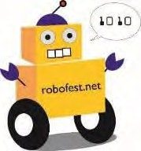
Little Robots, Big Missions
BottleSumo Committee Members Prof. Elmer Santos *
Priya Boopalan David Carbery P.E. Karthik Devaraj
Prof. Peter Guenther Chris Parker
* Committee Chair
Questions?
Send questions to: robofest@LTU.edu
Copyright © 2025- Robofest

